Slide 1
Computational Models of Decision Making
Peter Grabowski ’13
Professor Matthew Botvinick
March 6th 2011

Slide 2
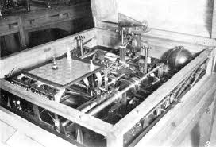
Original Motivation

Slide 3
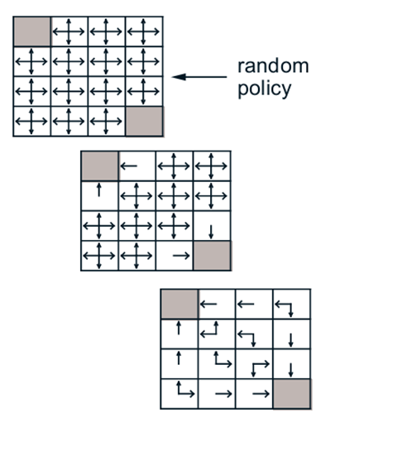
Map States to Actions

Slide 4
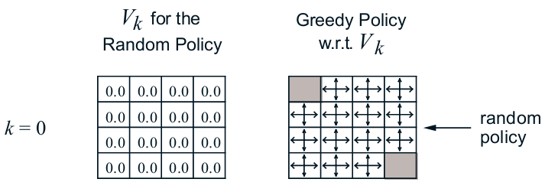
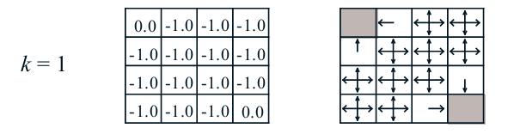
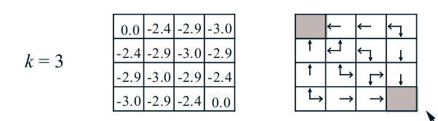
Map States to Values

Slide 5
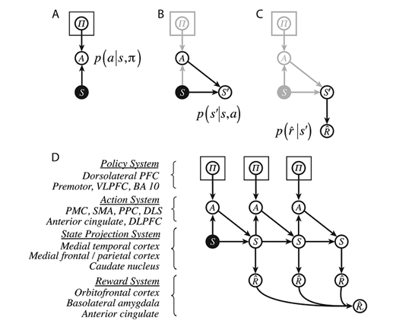
Model Based Learning

Slide 6

Model Based

Slide 7

Model Based

Slide 8

Model Based

Slide 9

Model Based

Slide 10
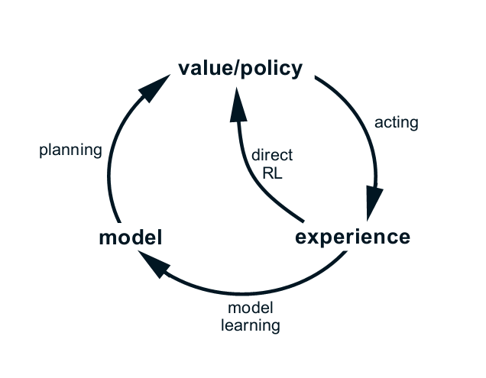
Model Free Vs. Model Based

Slide 11
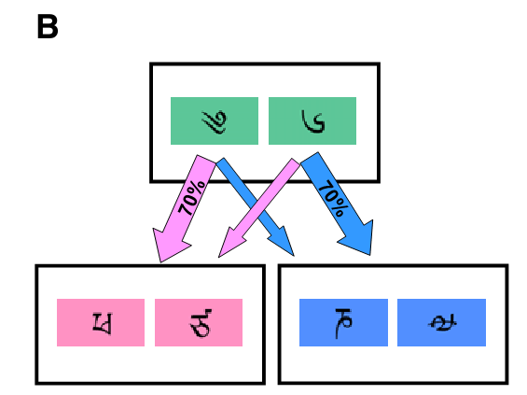

Slide 12
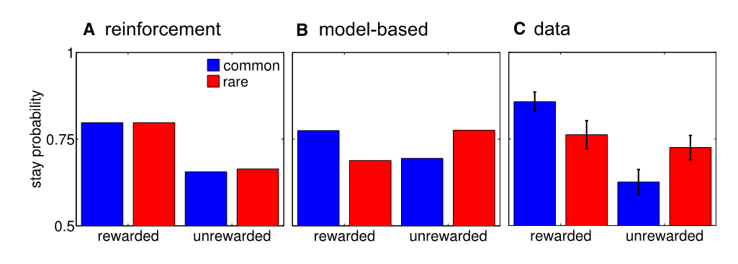

Slide 13
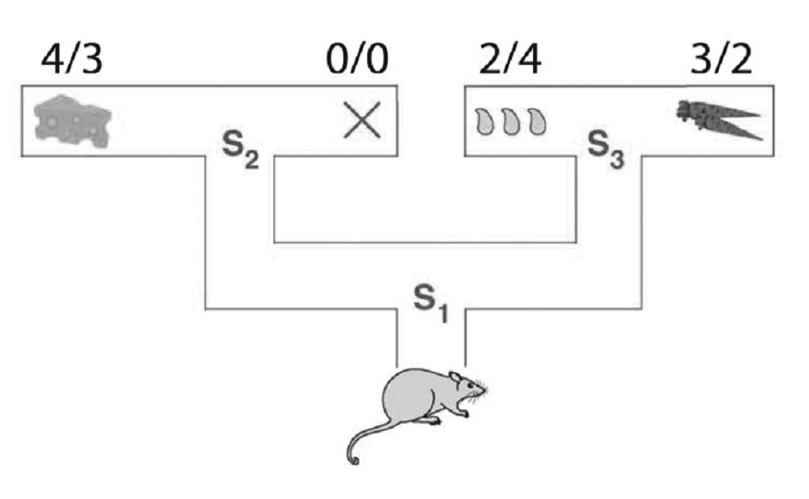

Slide 14
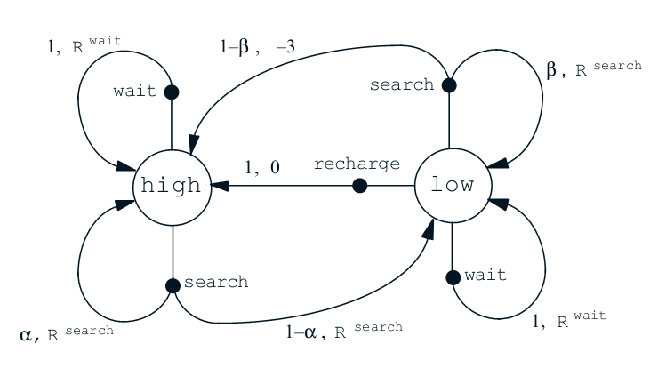

Slide 15
